Slide 1

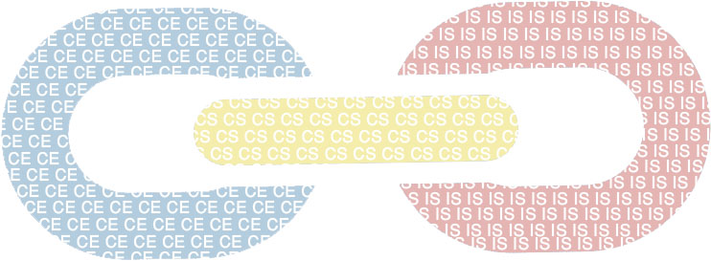
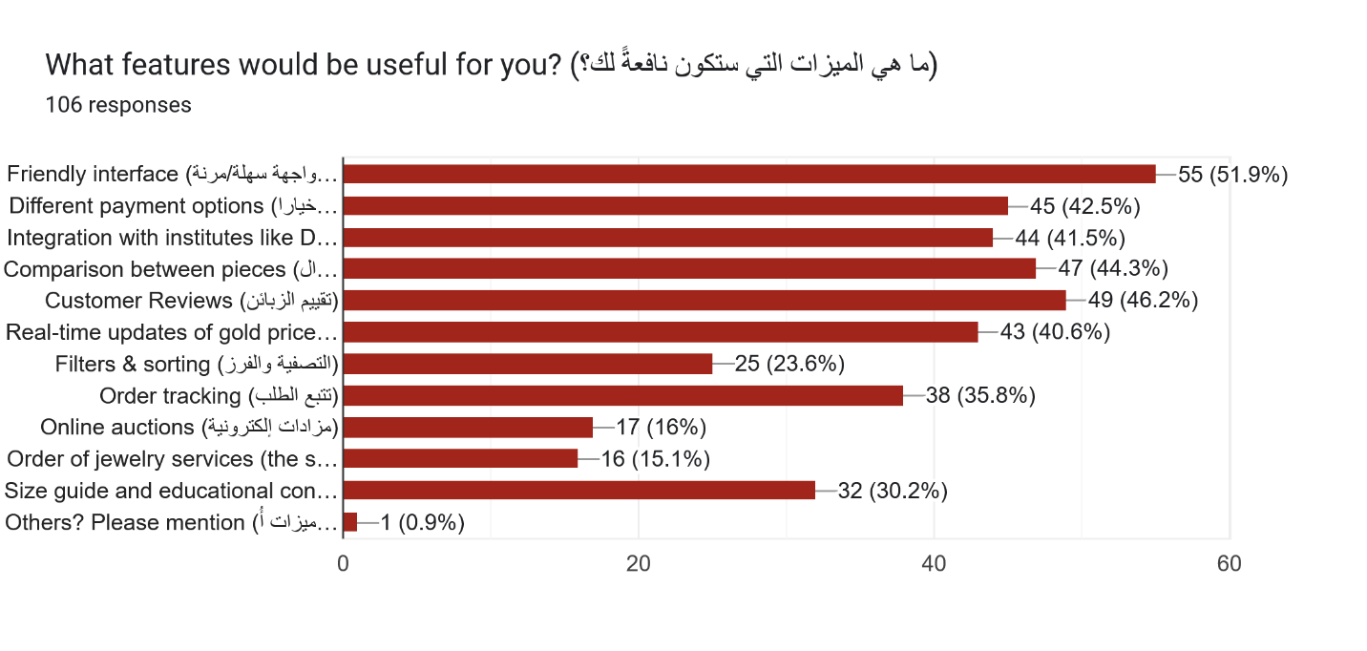
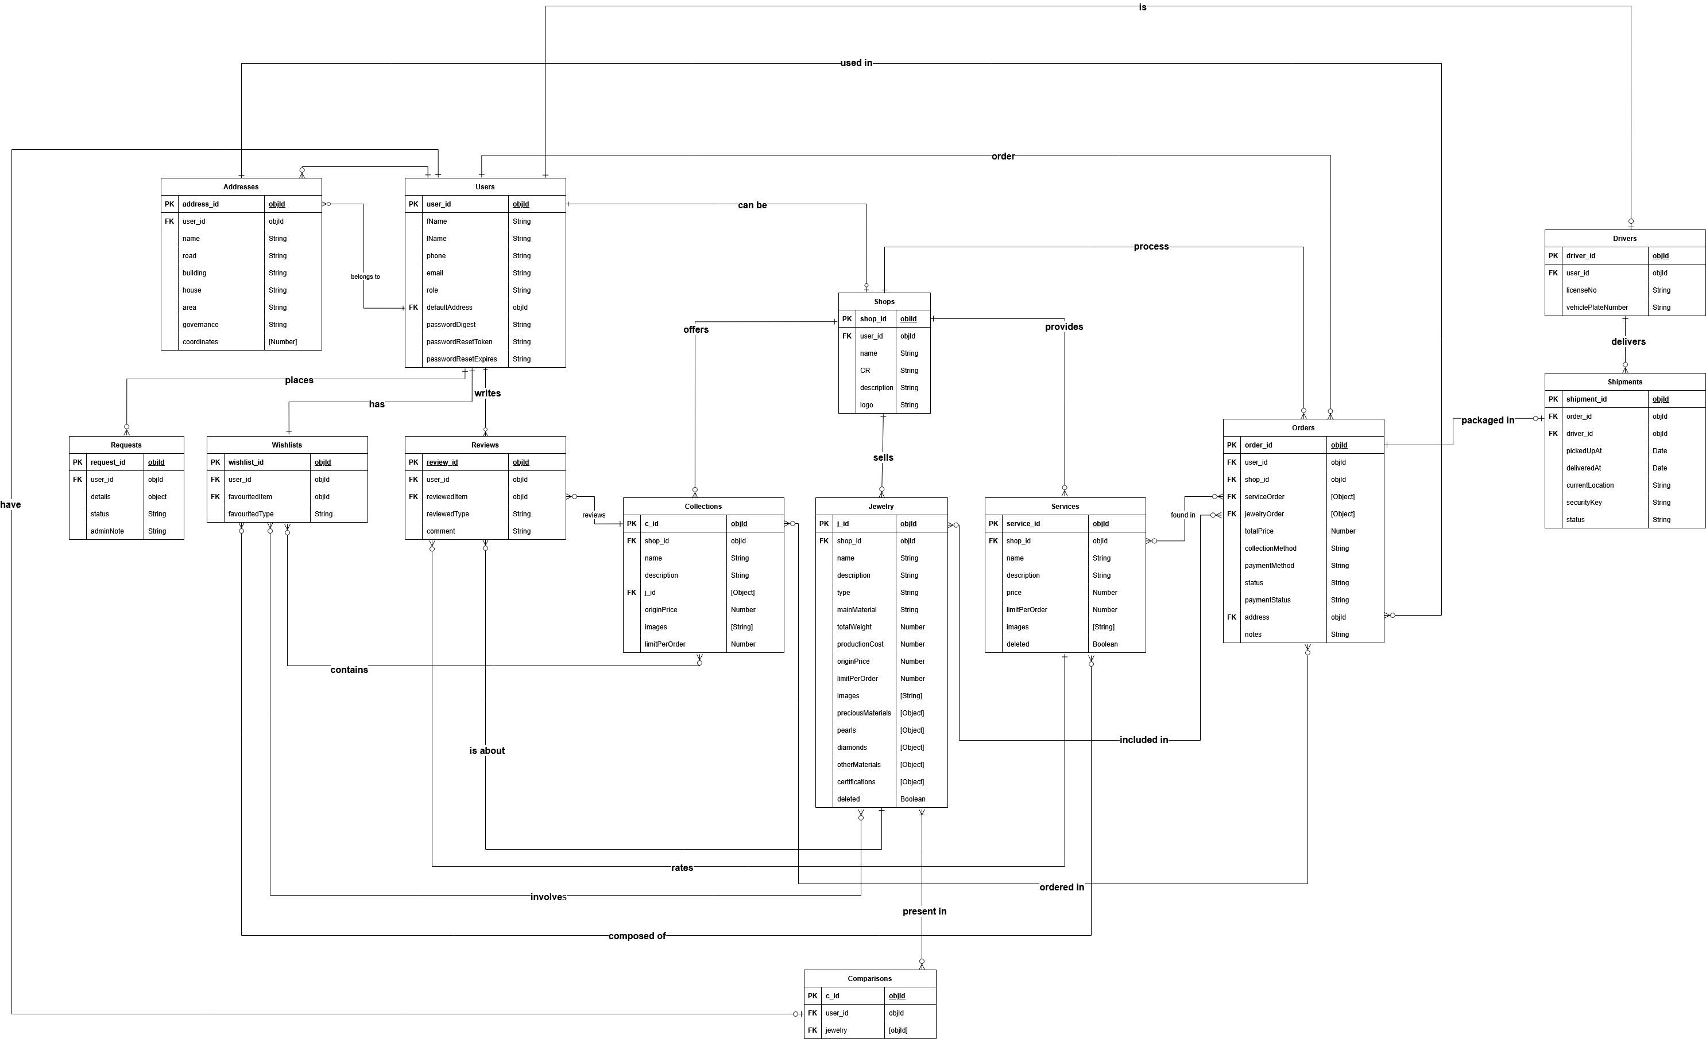
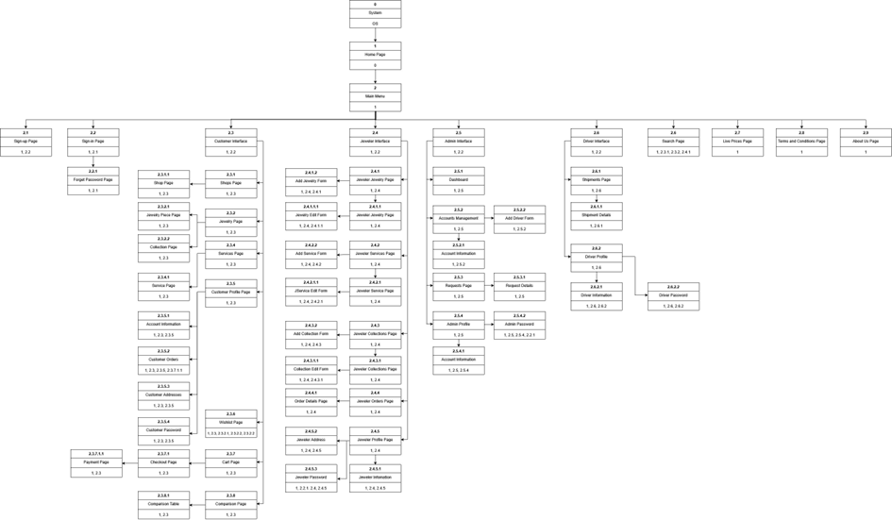
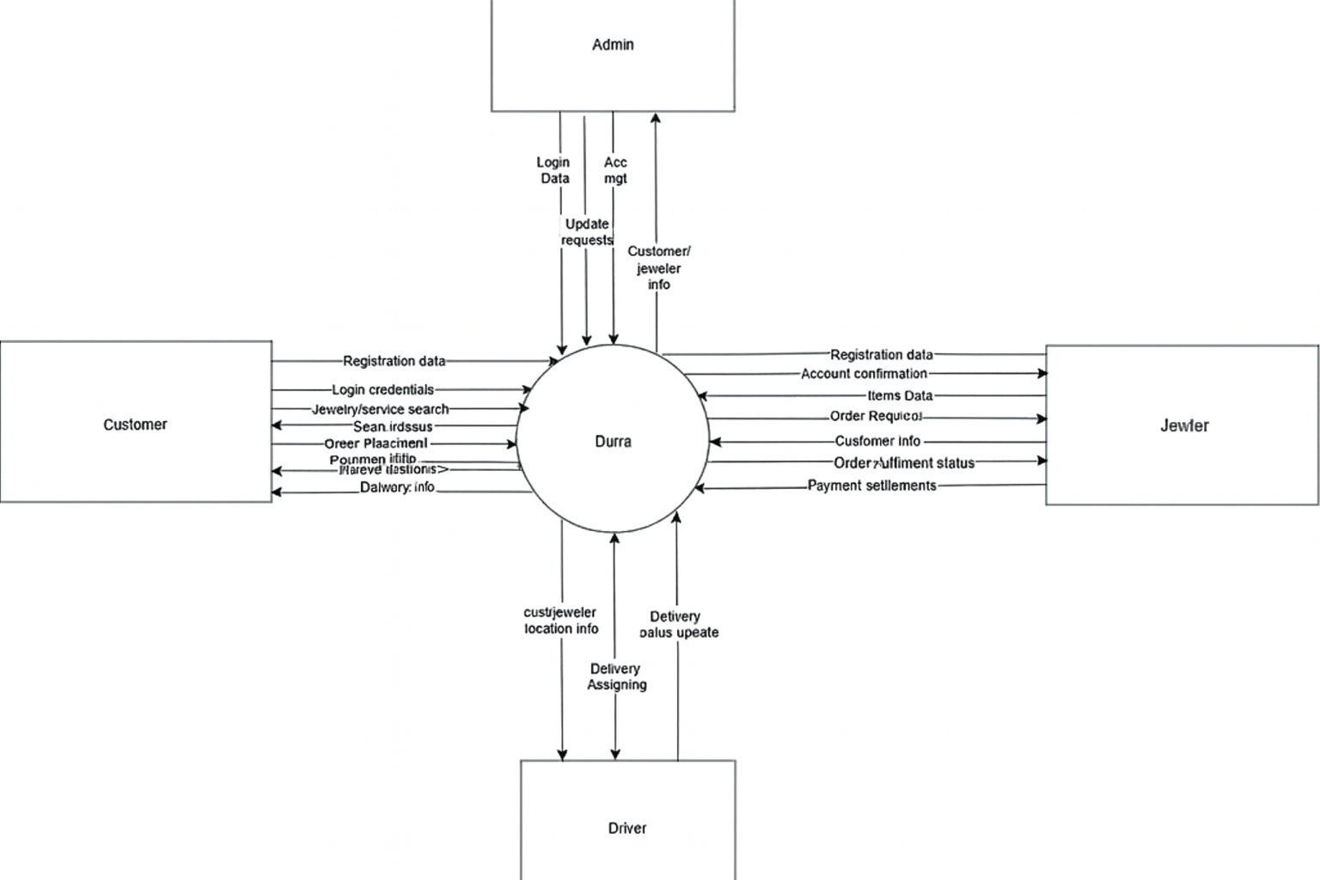
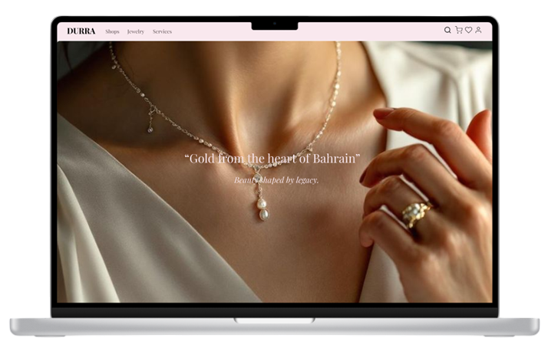
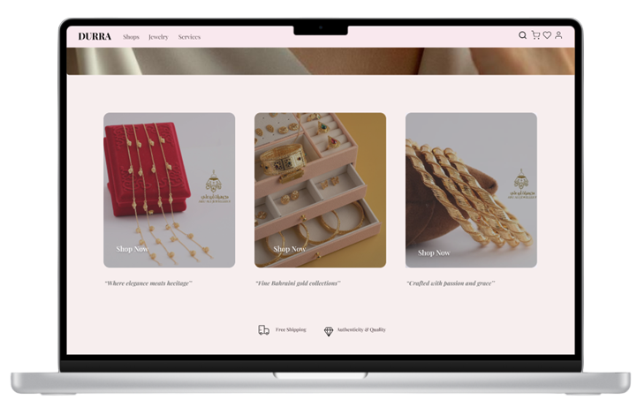
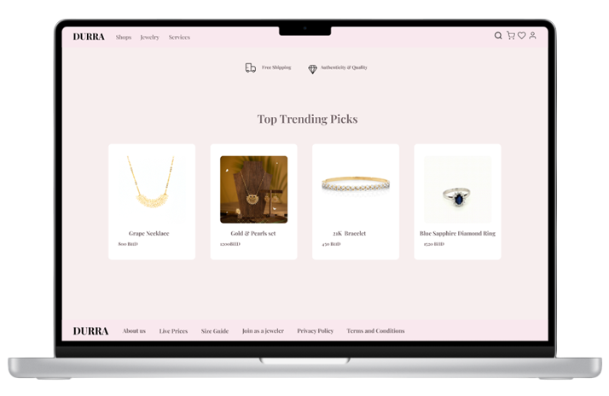
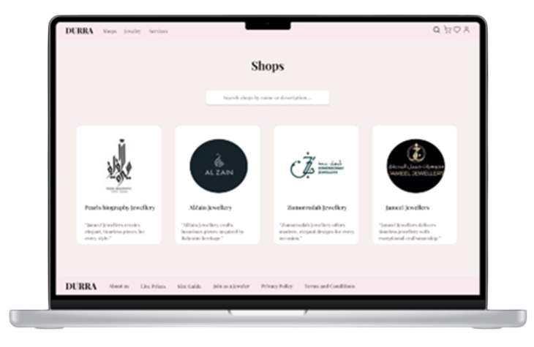
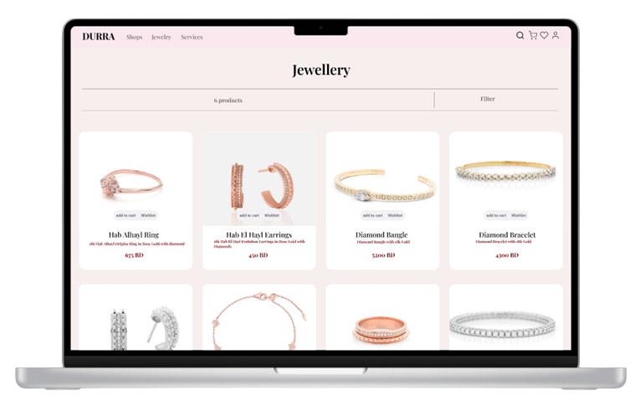
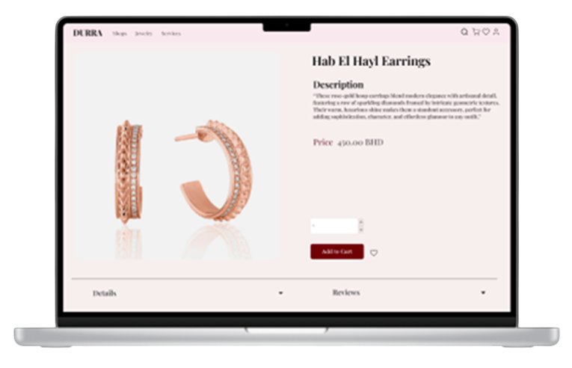
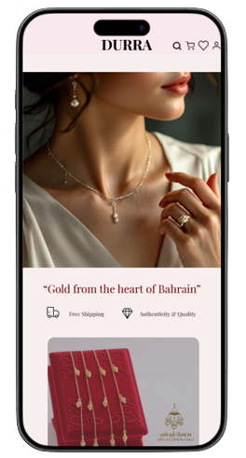
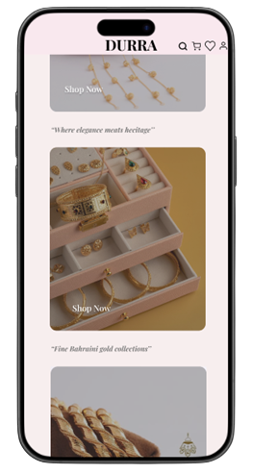
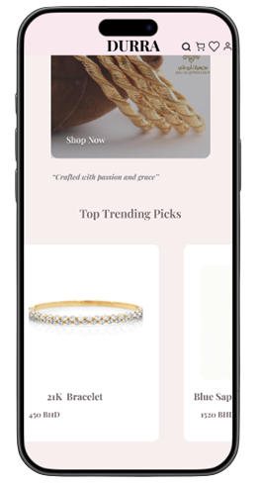
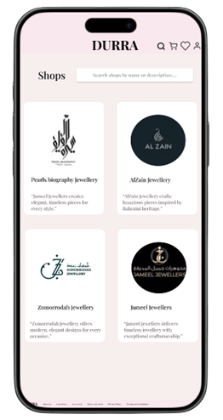
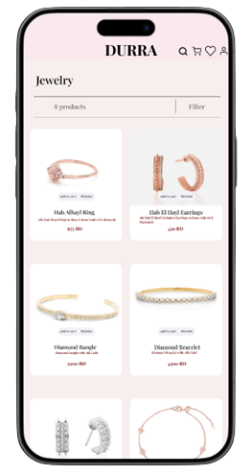
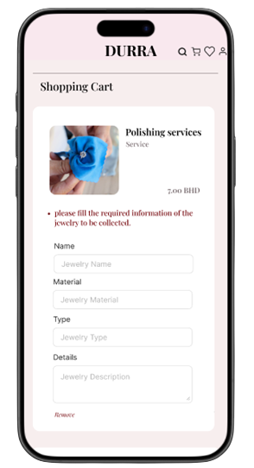
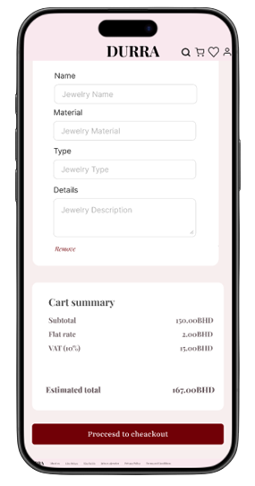
University of Bahrain
College of Information Technology
Department of Information systems
durra: a jewelry digital marketplace
Kawthar Mohammad, 202106083; Ghadeer Abdulla, 202104698; Ragad Abdulla, 202109753
Supervised By: Dr. Maan Aljawder
Abstract
Objectives
Durra is a user-centered digital marketplace designed to connect Bahraini jewelers with buyers, improving visibility and simplifying the shopping experience. Built through market research, prototyping, and iterative testing, the platform emphasizes usability and trust. Future plans include reselling, real-time order tracking, mobile app development, expanded regional support, and integrations with authentication and certification providers.
To provide a unified digital marketplace that enhances the visibility of local Bahraini jewelers while simplifying the customer journey through improved search, comparison, and authentication of fine jewelry. Durra aims to ensure trustworthy information, support post-sale services, and deliver a seamless, efficient shopping experience aligned with Bahrain’s market needs.
Methods/Diagrams/Figures
The Most Required Features
Durra Data Flow Diagram Level 0
Durra Entity Relationship Diagram (ERD)
Durra Dialogue Diagram
Results
Conclusion & Future work
Durra is a user-focused jewelry marketplace that enhances visibility for local jewelers and supports informed shopping. Future work includes adding order tracking, reselling, multilingual support, payment integration, API services, and developing the full mobile application beyond the current partial prototype.

